Slide 1
Static Code Analysis Tool - Cppcheck
Project for CS5393 (Fall 2016)
Presenter: Vimmi Taneja

Slide 2
Agenda
Static code analysis
Introduction to Cppcheck
Features of Cppcheck
Programs
Strengths
Weaknesses
Q&A

Slide 3
Static Code Analysis
Process of examining the code without executing it.
Goal: Provide confidence that code is correct without executing it.
Done as part of Code Review
Commercial tools
PC-Lint
    Coverity
Free tools
  Clang
  Cppcheck

Slide 4
Cppcheck Introduction
Static analysis tool for C/C++
Open source
Detects the types of bugs that the compilers normally fail to detect
Works by dividing the code into tokens to which it applies patterns
Console and GUI version
Integrated into Code::Blocks
Can be integrated as a plugin for Eclipse, Hudson
Has found 100 bugs in various projects

Slide 5
CppCheck Features
Out of bounds checking
Memory leaks checking
Detect possible null pointer dereferences
Check for uninitialized variables
Check for invalid usage of STL
Checking exception safety
Warn if obsolete functions are used
And dozens more…

Slide 6
Important issues
Memory leak – Occurs when piece of memory that was previously allocated is not deallocated by the programmer.
Can slow down the program or even crash.
Buffer overflow - vulnerability which arises when a program attempt to put more data in a buffer than it can hold
Can lead to program crashes or it may enter infinite loops
Code red worm – loss of 2.62 billion USD worldwide

Slide 7
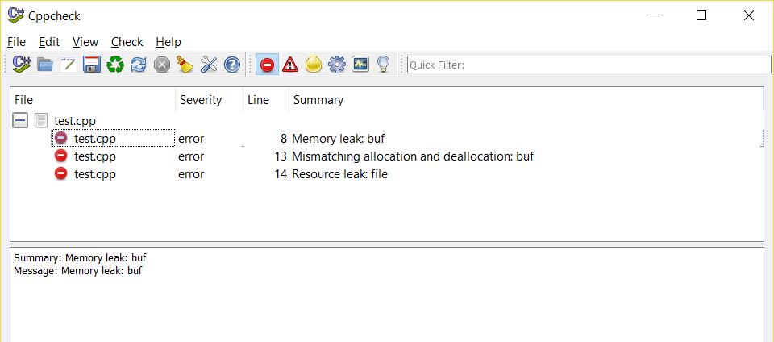
Programs
void foo(char* str)
{
char* buf = new char[8];
strcpy(buf, str);
FILE* file = fopen("out.txt", "w");
if(!file)
return;
for(char* c = buf; *c; ++c)
fputc((int)*c. file);
delete buf;
}

Slide 8
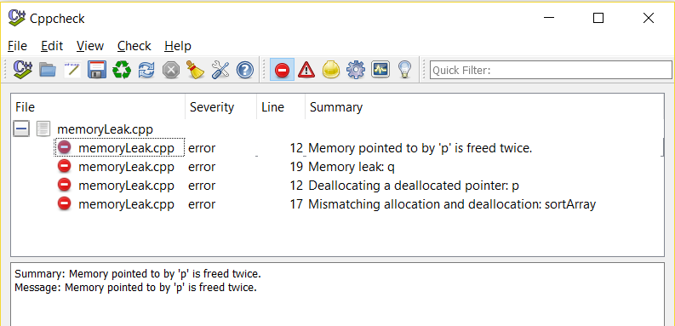
Memory Leak
void memLeak( )
{
int * p = new int; // unused allocated memory
delete p;
// Memory leak
int * q = new int;
*q = 15;
// no delete .. memory leak
delete p; // double free
int *sortArray;
sortArray = new int[5];
// mismatch allocation and deallocation
delete sortArray; // should be delete[]
}

Slide 9
Buffer overflow
Void bufferOverflow()
{
char buf[8];
strcpy(buf, “Buffer overflow”);
}
void memsetCheck()
{
char str[] = "almost every programmer should know memset!";
memset (str,'-',49); // buffer access out of bounds
puts (str);
}

Slide 10
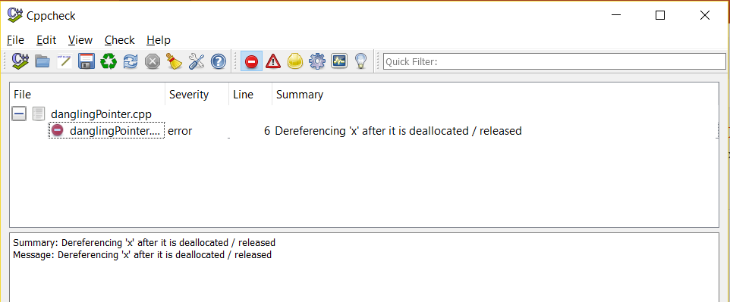
Dangling Pointer
void danglingPointer()
{
int* x = new int[5];
delete[] x;
int y = x[2]; // Dereferencing 'x' after it is deallocated
}

Slide 11
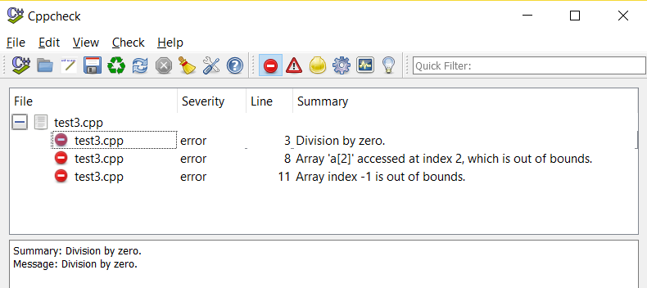
Other errors
int testDivide(int a , int b)
{
return a/b;
}
int main()
{
char a[2];
a[2] = 'c'; // array index out of bounds
int b = -1;
std::cout << a[b]; // negative index
// division by zero
testDivide(3, 0);
}

Slide 12
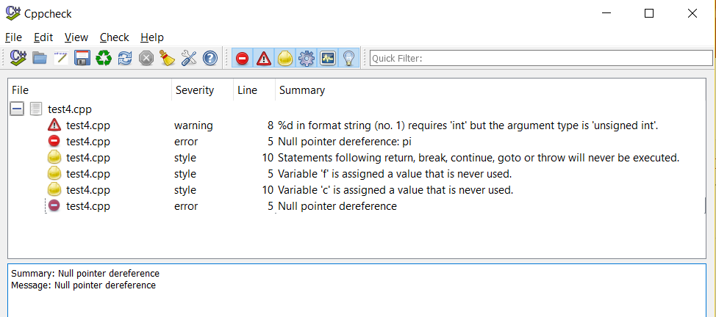
Other errors
int main()
{
int *pi, f;
pi = NULL;
f = *pi; // NULL pointer dereference
unsigned int uitest = 123456;
printf("%d", uitest);
return 0;
int c = b; // unreachable code.
}

Slide 13
Open source projects
5 open source projects checked
Type of errors – Null pointer dereference, array index out of bounds, memory leak, resource leak.
Project | Files checked | Errors | Warnings | Duration(s)
Synergy | 262 | 3 | 13 | 13
Wild magic 5 | 782 | 3 | 232 | 27
Eigen | 737 | 12 | 65 | 31
OpenDDS | 931 | 4 | 20 | 52
Mplayer | 648 | 191 | 559 | 212

Slide 14
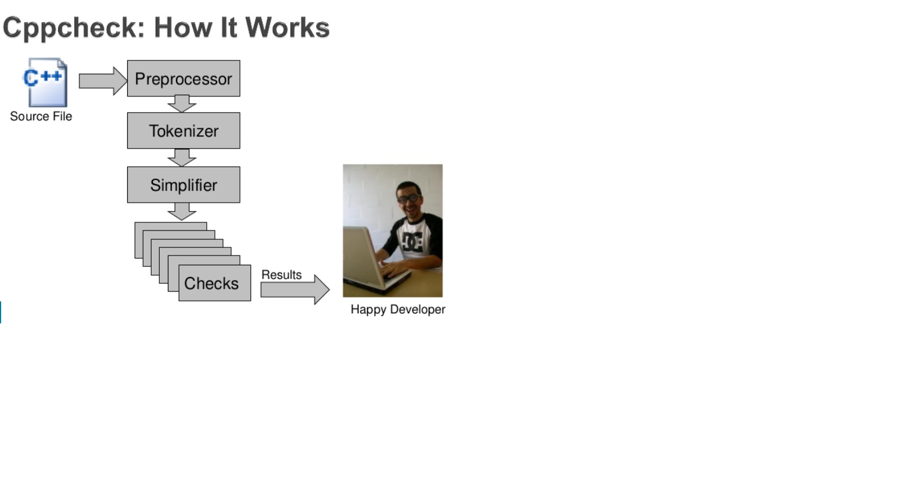
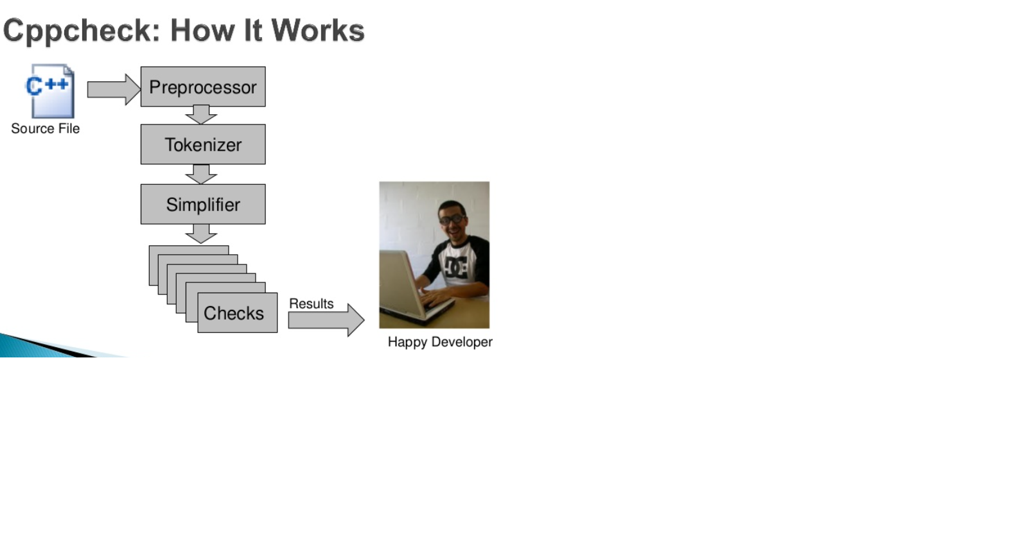
Cppcheck – How it works

Slide 15
Strengths
Plugins and integrations for several IDE: Eclipse, Hudson, Jenkins, Visual Studio.
Keep on updating every month.
Easily applicable to any file and ability to scan all files even outside the build.
Available in many world languages, including English, Dutch, Finnish, Swedish, German, Russian, Serbian and Japanese.
Easy to use, install and clear messages.
Weaknesses
Doesn’t detect many bugs (as with most of the other tools) since it has less information to use.
Customization requires good deal of effort
Issues detected are shallower than those detected by other tools.

Slide 16
Q&A
THANK YOU!

